Slide 1

Wireless Networking
Ambuj Varshney
Assistant Professor, National University of Singapore
Wireless, Embedded Intelligence, Sensing, and Emerging Technologies Group
ambujv@nus.edu.sg

Slide 2
Learning Objective for Today’s Lecture
Review: last few lecture’s topics
Localisation basics and RSSI
Case Study: Radio Tomography
Other Ranging Methods
Global Positioning System
Indoor Localisation
Fingerprinting
Ultrawide band
Other methods

Slide 3
Administration and Course Logistics

Slide 4
Assignment 2
Link: https://weiserlab.github.io/ambuj/cs4222_assignment2
Deadline: 3rd of March 2023
Covers: 7% of overall grade
Program Sensor Tag, Implement State Machine, Using Actuators and Sensors
No Plagiarism! We will check for code similarity
No ChatGPT for this assignment
Will be informed of link to submit the assignment
Notes:
++ We may all have heard of the term Internet of Things. So how are these wireless embedded systems related to the Internet of Things: Today, IoT includes a broad class of devices, including powerful platforms such as smartphones. However, it also includes more resource-constrained devices and what we call Wireless Embedded Systems, and in fact, I consider it to be one of the essential parts of the IoT ecosystem.
++ These are platforms equipped with a radio transceiver, sensor, microcontroller, and some form of energy storage. These platforms also often form a network, and sensor network as it is called has been an active area of research for the past two decades.
++ The research community has also developed wireless embedded platforms which we may know about, and these include: CMUCAM, which is an image sensor platform developed at Carnegie Mellon University, or Permamote is long life sensor platform from the lab I am associated with at UC Berkeley or Lorea which is a long-range backscatter platform that I had developed as part of my doctoral dissertation at Uppsala University. All of these are an example of Wireless Embedded Systems.

Slide 5
Tutorials
Solutions to all the tutorials are available (except this week)
Tutorial 4
Calculation of power consumption for wireless technologies
Battery capacity
Low-Power Backscatter like communication
Notes:
++ We may all have heard of the term Internet of Things. So how are these wireless embedded systems related to the Internet of Things: Today, IoT includes a broad class of devices, including powerful platforms such as smartphones. However, it also includes more resource-constrained devices and what we call Wireless Embedded Systems, and in fact, I consider it to be one of the essential parts of the IoT ecosystem.
++ These are platforms equipped with a radio transceiver, sensor, microcontroller, and some form of energy storage. These platforms also often form a network, and sensor network as it is called has been an active area of research for the past two decades.
++ The research community has also developed wireless embedded platforms which we may know about, and these include: CMUCAM, which is an image sensor platform developed at Carnegie Mellon University, or Permamote is long life sensor platform from the lab I am associated with at UC Berkeley or Lorea which is a long-range backscatter platform that I had developed as part of my doctoral dissertation at Uppsala University. All of these are an example of Wireless Embedded Systems.

Slide 6
Videos and Prompts
AIM: Update everything before end of this week (Sunday)
Delay in releasing tutorial ☹
No mid-term ☺ Good luck for other courses
Any issues or suggestions?
Notes:
++ We may all have heard of the term Internet of Things. So how are these wireless embedded systems related to the Internet of Things: Today, IoT includes a broad class of devices, including powerful platforms such as smartphones. However, it also includes more resource-constrained devices and what we call Wireless Embedded Systems, and in fact, I consider it to be one of the essential parts of the IoT ecosystem.
++ These are platforms equipped with a radio transceiver, sensor, microcontroller, and some form of energy storage. These platforms also often form a network, and sensor network as it is called has been an active area of research for the past two decades.
++ The research community has also developed wireless embedded platforms which we may know about, and these include: CMUCAM, which is an image sensor platform developed at Carnegie Mellon University, or Permamote is long life sensor platform from the lab I am associated with at UC Berkeley or Lorea which is a long-range backscatter platform that I had developed as part of my doctoral dissertation at Uppsala University. All of these are an example of Wireless Embedded Systems.

Slide 7
Learning Objective for Today’s Lecture
Review: last few lecture’s topics
Localisation basics and RSSI
Case Study: Radio Tomography
Other Ranging Methods
Global Positioning System
Indoor Localisation
Fingerprinting
Ultrawide band
Other methods

Slide 8
Review of Last Lecture

Slide 9
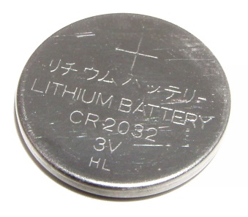
How do you measure battery life?
Battery lifetime: The watt-hour (symbolized Wh) is a unit of energy equivalent to one watt (1 W) of power expended for one hour (1 h) of time.
Example:
Dell Latitude E7440 Laptop (3 cell): 34Wh - provides 1W for 34 hours.
iPad2: 25 watt-hour
An ampere-hour or amp-hour (Ah) is a unit of electric charge equal to the charge transferred by a steady current of 1A flowing for one hour,
iPad2 6930mAh, voltage = 25Wh/6.9Ah = 3.6V
Samsung S4: 2600mAh (3.7V), 9.62Wh
AA Energizer Alkaline: 2500 mAh (1.5V), 3.75Wh
Calculator Battery (CR2032): 225 mAh (3V), 0.675Wh

Slide 10
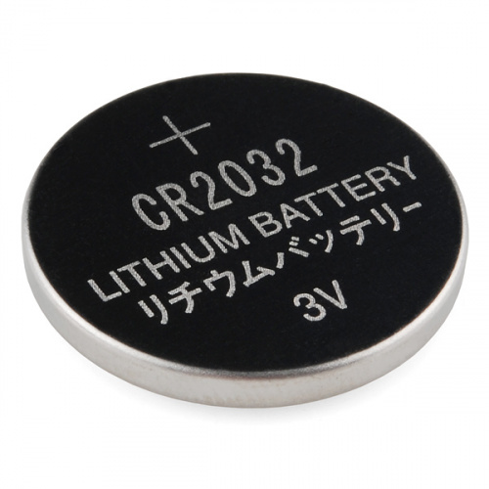
What is the capacity of the battery?
How do we calculate the lifetime of the battery in IoT devices?
We express battery capacity commonly in milliampere-hour (mAH)
Coin cell (CR2032): 240 mAh, Flexible battery (Molex): 10 mAh
How long would battery last under different device load:
Current drawn | Lifetime
240 mA | 1 h
120 mA | 2 h
1 mA | 240 h
Coin cell battery
CR 2032 (240 mAh)

Slide 11
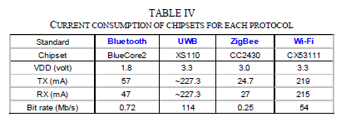
Energy consumption for wireless networking
Table taken from Jin-Shyan Lee, Yu-Wei Su, and Chung-Chou Shen, “A Comparative Study of Wireless Protocols: Bluetooth, UWB, ZigBee, and Wi-Fi,” IECON, 2007
A mobile device with a battery capacity 9.62Wh transmits continuously on:
WiFi:
Considering only network energy consumption
Power consumption: 3.3V*219mA = 722.7 mW
Duration = 9.62/0.7227 = 13.3hrs
In practice, the duration is much shorter due to energy consumed by other components
Bluetooth: (1.8V * 57mA = 102.6mW)
Duration = 9.62/(1.8*0.057) = 93.76hrs

Slide 12
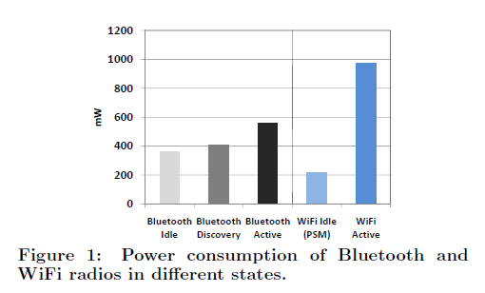
Energy consumption for wireless networking
Devices rarely transmit continuously.
Having different power states allow power consumption to be reduced
Ashish Sharma, Vishnu Navda, Ramachandran Ramjee, Venkat Padmanabhan, and Elizabeth Belding, Cool-Tether: Energy Efficient On-the-fly WiFi Hot-spots using Mobile Phones, in CoNEXT 2009.

Slide 13
Bluetooth Low Energy (CC2640)
Tx Current: ~ 6.1mA (0dBm)
Tx Current: ~ 15mA
Latency: 3 ms
Sleep current ~ 1µA
Designed for sending small chunks of data
J. Lindh, Measuring Bluetooth Low Energy Power Consumption; Application Report, Texas Instruments, 2017.

Slide 14
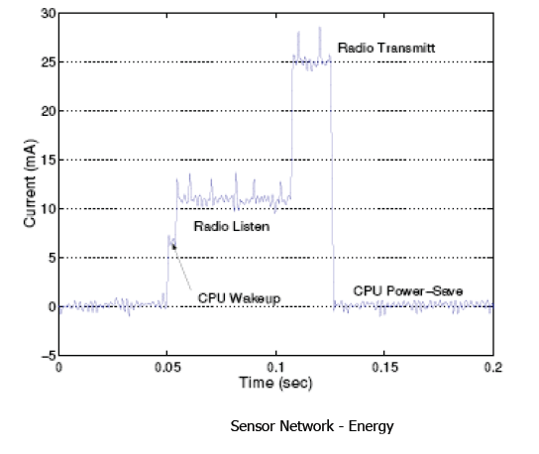
Current Consumption (MICA2 Sensor node)
What are the desirable properties for radio to operate in low power?

Slide 15
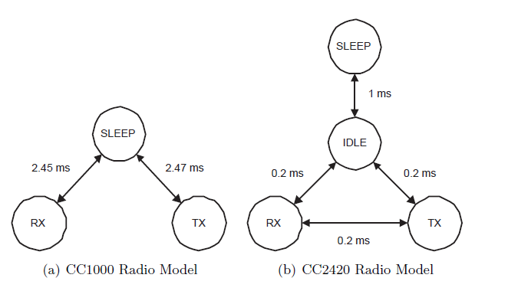
Example of Different Radio States
Energy can be saved by putting the network interfaces into low power states when they are not active

Slide 16
Energy consumption/Lifetime for a IoT device
Sample values
Basic Energy consumption : 10mA
Transmitting (PTX) : 20mA
Receiving (PRX) : 10mA
Sleeping : 0.1mA
Battery = 2 (1.5V) AA batteries, each provides 2300 mAh
Total battery power = 2 * 1.5 * 2.3 = 6.9Wh

Slide 17
Energy consumption/Lifetime for a IoT device
Duration of active period (compute + transmit) = 3.6ms
Current drawn per cycle = 0.02 + 0.048 = 0.068mAs
Let sensor node operates continuously:
Current drawn = 0.068 mAs /0.0036 = 18.89mAs
Lifetime = (2300*3600) mAs / 18.89 = 438,327s or 122hr or ~5days

Slide 18
Energy consumption/Lifetime for a IoT device
Let sensor node operates once a second
Idle period = 0.9964s
Current drawn during idle period = 0.1 * 0.9964 = 0.09964mAs
Average current drawn (over 1 s) = 0.068 + 0.09964 = 0.1676mAs
Lifetime = (2300*3600) mAs / 0.1676 = 13,723hr or 572days

Slide 19
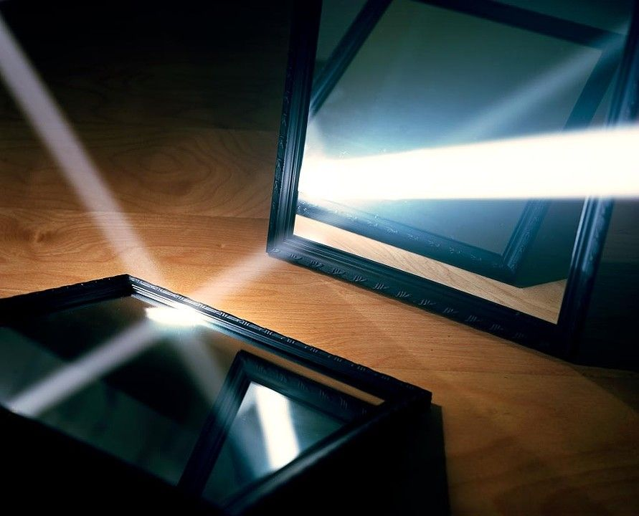
One way to understand backscatter transmissions
Notes:
++ While we are deploying an enormously large number of IoT devices, I claim that very little attention is being paid to their energy challenge.
++ Today, most IoT devices are very energy expensive, and consequently, they rely on bulky batteries such as AA/AAA sized batteries for their operation. Even when operating on these batteries, they require frequent replacement of the exhausted batteries. This can be challenging when performed at a massive scale, especially considering that we may have a trillion embedded device deployed in the world.
++ Further, it can also harm the environment. These batteries use toxic chemicals, which means now we can have billions of toxic chemicals laden batteries that would be disposed of in landfills. This is especially important as sustainability has become an essential aspect across the world; in fact, imperial college was celebrating sustainability week.

Slide 20
Basics of backscatter communication
Vary between absorbing or reflecting signal to modulate data
Wireless transmissions at microwatts of power draw (10000x energy savings)
Frequency bands: 400 MHz, 900 MHz, 2.4 GHz
Ambient RF signal
Antenna
Reflected (backscatter) signal
RF Switch
Modulating Signal (Digital)
Backscatter tag
Reader/ Receiver

Slide 21
Backscatter transmits at (up to) 10000x lower power consumption than conventional radios
Backscatter through absorption or reflection of ambient wireless signals enables wireless transmissions at microwatts of power consumption
Ambient RF signal
Antenna
Reflected (backscatter) signal
RF Switch
Modulating Signal (Digital)
Backscatter tag
Receiver
Notes:
Backscatter communication actually help us overcome this limitation

Slide 22
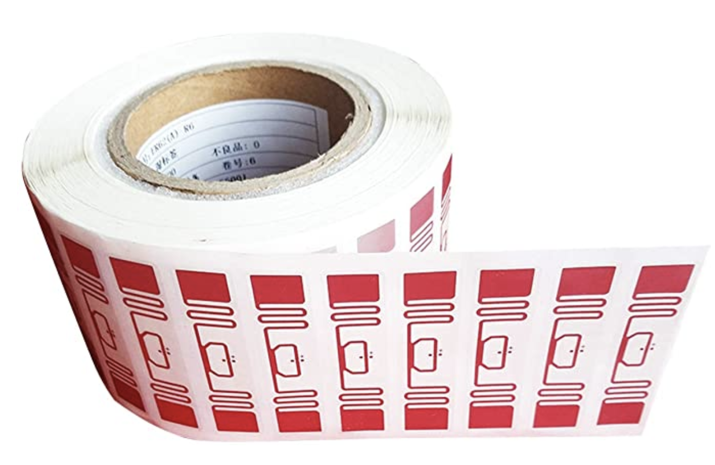
RFID is everywhere nowadays
Fundamental design principle is asymmetry
Extremely simple, cheap tags
Complex readers

Slide 23
What are challenges with RFID systems?
Essentially free communication!
What’s the cost (besides having a higher-capability device)
Difficult to reflect energy when it is already so low
Essentially double the path loss (there and back)
Range is very limited (or transmit power needs to be high)
Meters of range, maximum
Centimeters for inductive coupling
Alternatively, could decouple signal generation from reception

Slide 24
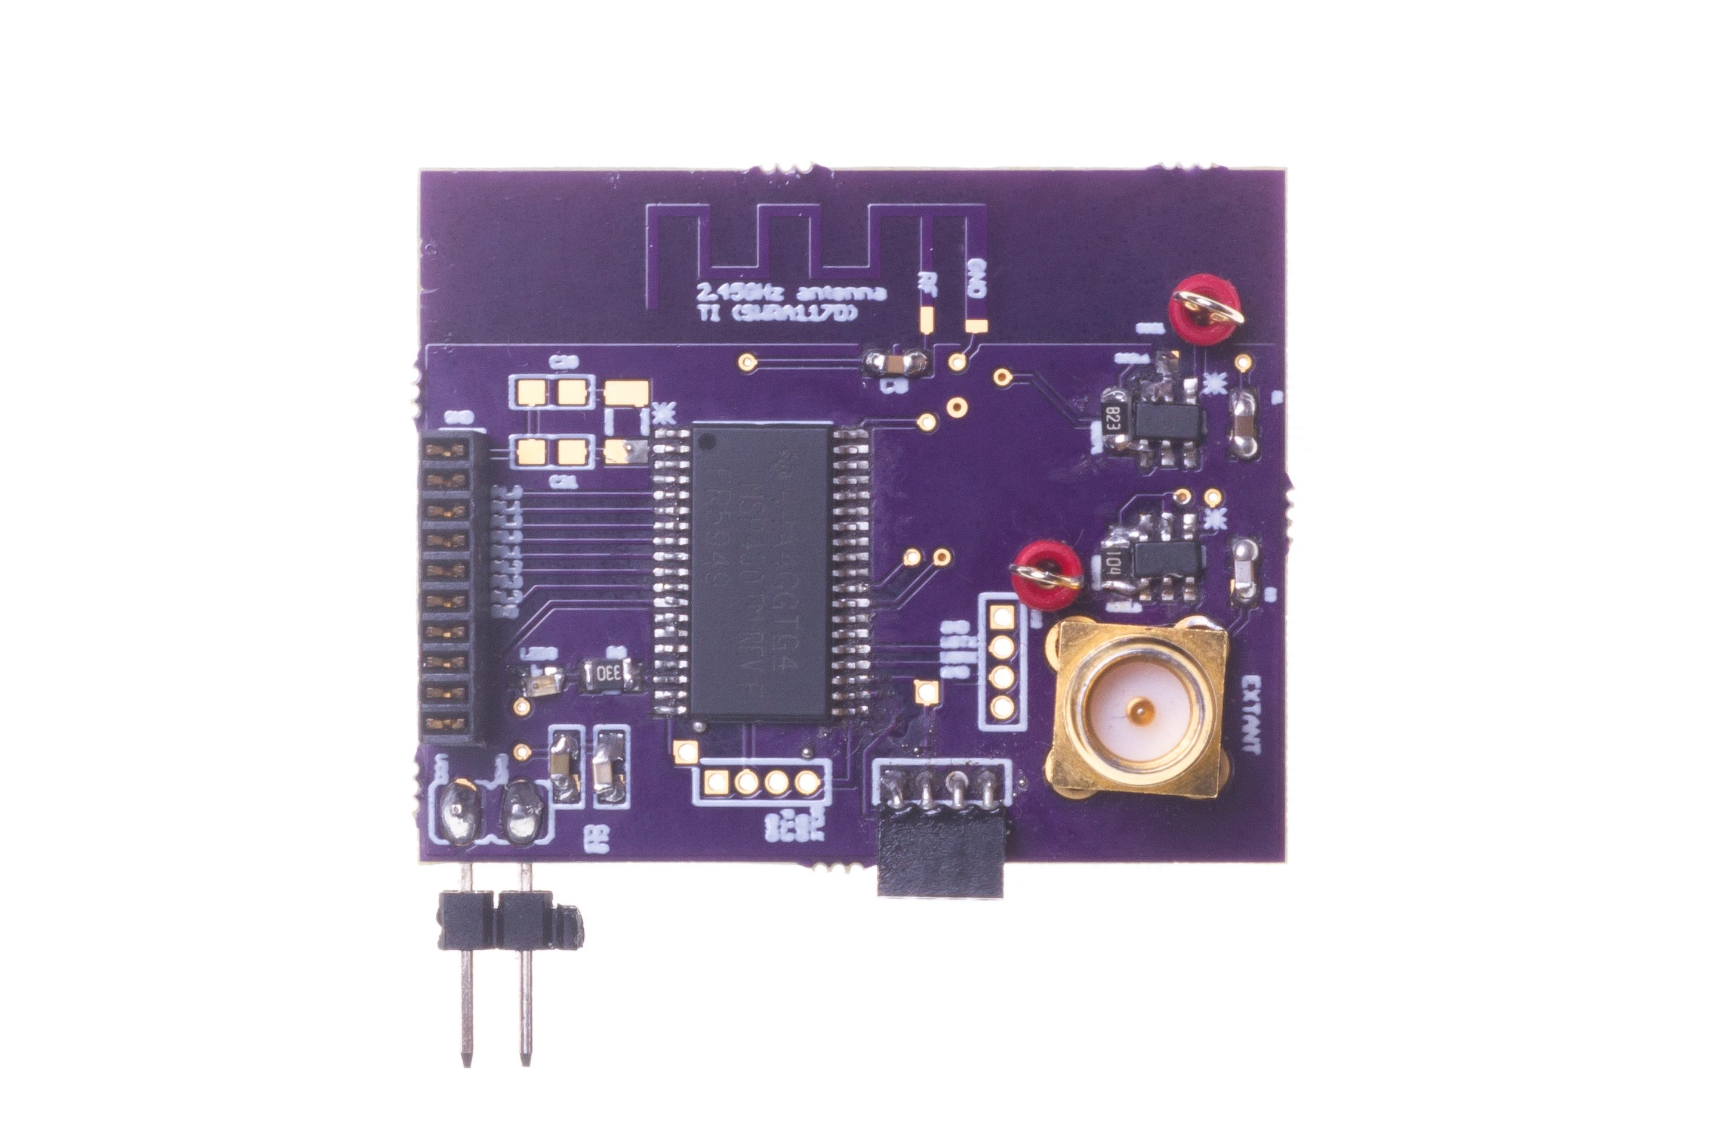
Long range backscatter transmissions using LoRea
LoRea is a long range, low-power, and low-cost backscatter architecture
System Overview
Backscatter Tag Hardware Prototype
(Peak Power of 70 µW)
Varshney et al. ”LoRea: A Backscatter architecture that achieves a long communication range” ACM SENSYS 2017
Notes:
+ Over the past several years, I have designed systems that overcome these critical limitations that have hindered the backscatter systems and have the prevented widespread adoption of the backscatter mechanisms on the Internet of Things devices. One of these systems is LoRea.
+ LoRea was presented at ACM SENSYS, which is a flagship conference in the area of embedded sensor systems. I show the architecture of LoRea on the left-hand figure on the slide. It consists of one or more commodity devices such as a smartphone or Wi-Fi router that provides the necessary carrier signal to support backscatter transmissions, a low-power backscatter tag that I had designed and transmit at a peak power of 70uw, and one or more receiver of backscatter transmissions.
+ The key highlight of LoRea was that it could achieve a significantly larger communication range than existing systems, was designed using off the shelf components and cost (few tens of USDs). Further, the backscatter tag could achieve this capability at orders of magnitude lower energy than commercially available radio transceivers.
+ How did LoRea achieve this capability? We would describe next.

Slide 25
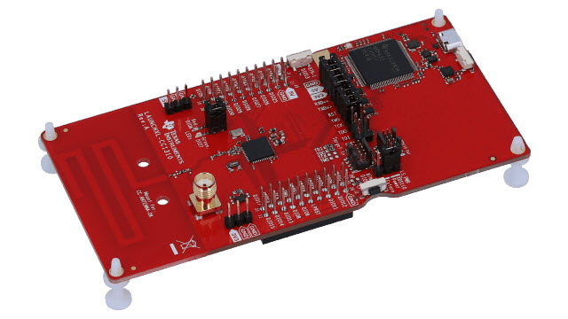
LoRea bridges the energy asymmetry between communication (TX), sensing and processing
Off-the-shelf hardware for transmission and receptions. Tens of USD
Overturn notion that backscatter is a short-range transmission mechanism
Component | Power Consumption
LoRea (Transmissions) | 70 µW (868 MHz)
Conventional Transceiver | Tens to hundreds of mW’s
Microcontroller (Apollo3) | 100s of µW’s
Sensors | Few to tens of µW’s
LoRea transmits at similar power consumption as a sensor
Texas Instruments CC1310 Launchpad: Receiver
Backscatter Tag Hardware Prototype
(Peak Power of 70 µW)
Notes:
+ Thus, with LoRea, we were able to design a backscatter system that was able to overcome the range and cost limitations that had limited all the existing backscatter system, and had hindered the widespread usage of the mechanism on the IoT devices
.
+ In fact, the backscatter tag even though it was designed using off-the-shelf components is orders of magnitude more efficient than commercial transceivers while supporting orders of magnitude lower power consumption.
+ the entire backscatter setup costs just few tens of USDs, which dramatically lowers the cost of infrastructure required to support the backscatter tags and carrier emitter device.

Slide 26
What is the expected lifespan of a battery?
Coin cell (CR2032): 240 mAh, Flexible battery (Molex): 10 mAh
Backscatter transmitter: (LoRea, SENSYS 2017) – 35 uA
Let’s estimate long would battery last under different device load:
Component | Current draw | Flexible Battery | Coin cell
Microcontroller | 200 uA | 50 h | 1200 h
Accelerometer | 10 uA | 1000 h | 24000
WiFi Transmitter | 15 mA | 45 mins | 16 h
Bluetooth Transmitter | 1 mA | 10 h | 240 h
Backscatter Transmitter | 35 uA | 285.7 h | 6857 h

Slide 27
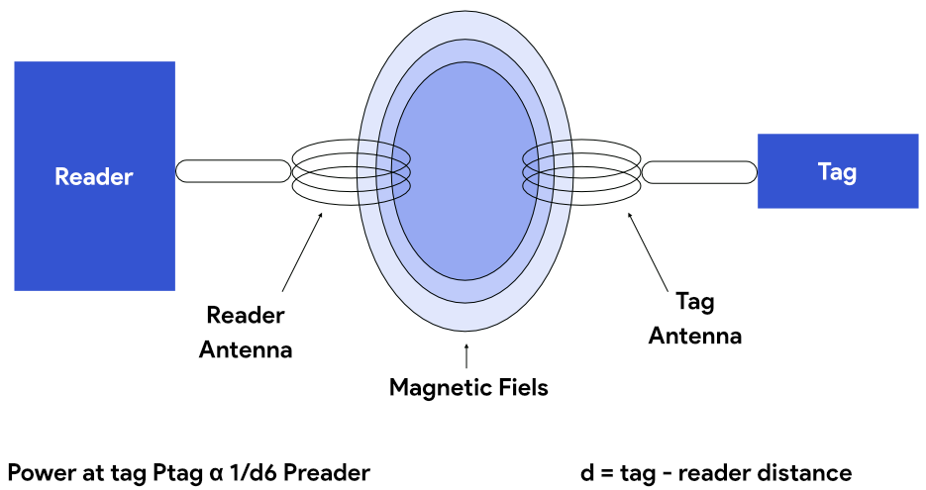
Communication using inductive coupling
A shared magnetic field is created between the two devices
Change in current through one device induces current change through the other
Device can vary load to transmit data
Very low frequency bands (135 KHz, 13.56 MHz)
Transmit through materials including skin
Sensitive to metal

Slide 28
Near Field Communication (NFC)
Inductive Coupling concept (13.56 MHz)
But attached to a powered and capable device (smartphone)
10-20 cm range max (usually <10)
Can act as a tag or as a reader
Allows smartphone to power a tag if needed
Alternatively, smartphone could act like a card and respond to a reader
Two smartphones can communicate without power transfer
Data rate 100-400 kbps!
nRF52840 capable of 100 kbps communication with attached antenna

Slide 29
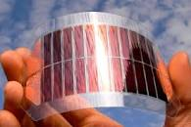
What's next? Transmissions on harvested energy
𝜇W
Energy harvester
Microwatts of power available to harvest from ambient sources
Notes:
++ The high-power consumption for the IoT platforms also blocks an important and promising direction to enable the sustainable deployment of large-scale embedded devices. This is to eliminate batteries from these platforms altogether. If we eliminate batteries, how do we power these devices?
++We use the fact that ambient energy sources surround us. We are constantly bombarded with radio frequency transmissions such as television, wifi, radio signals, or we have waste heat energy sources, or the indoor light is ubiquitous. All these sources could be harvested to derive energy to power the IoT devices and platforms and eliminate the overhead associated with batteries on these platforms. However, the challenge that we encounter is that we could only derive microwatts of power from these ambient sources, which is sufficient to power the sensors and microcontrollers. However, we need orders of magnitude higher power for operating radio transceivers such as LoRa. This makes it challenging, if not impossible, to power sensors through energy derived from the environment.

Slide 30
Energy Harvesting
Batteries/Capacitors can potentially be recharged by environmental effects
Some examples
Solar : solar cell
Wind: micro wind turbine can be used to harvest wind energy readily available in the environment in the form of kinetic
Thermal: capture energy from industrial equipment, structures, and even the human body.
Vibration: vibration from engines can stimulate piezoelectric materials, as can the heel of a shoe.
Kinetic: translate movement to change in electromagnetic flux
Radio Frequency (RF): convert ambient RF signal into energy (demo video)

Slide 31
Localisation Basics

Slide 32
What is localization?
The goal of localization systems is to determine the physical coordinates of an electronic device such as IoT nodes, drones, mobile phones
These physical coordinates of electronic devices are:
Global - aligned with some externally meaningful systems like GPS
Relative - some “rigid transformation” (rotation, reflection, translation) away from a global coordinate systems

Slide 33
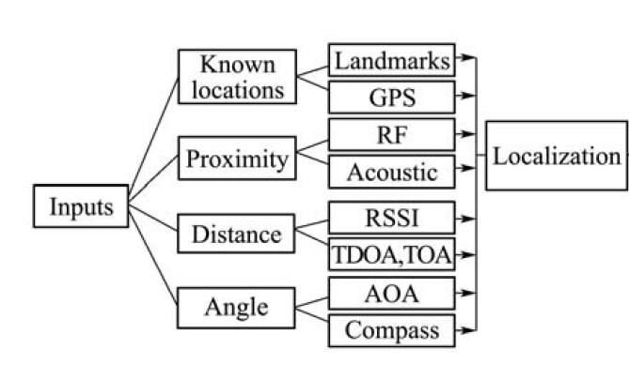
Overview of localization systems and modalities

Slide 34
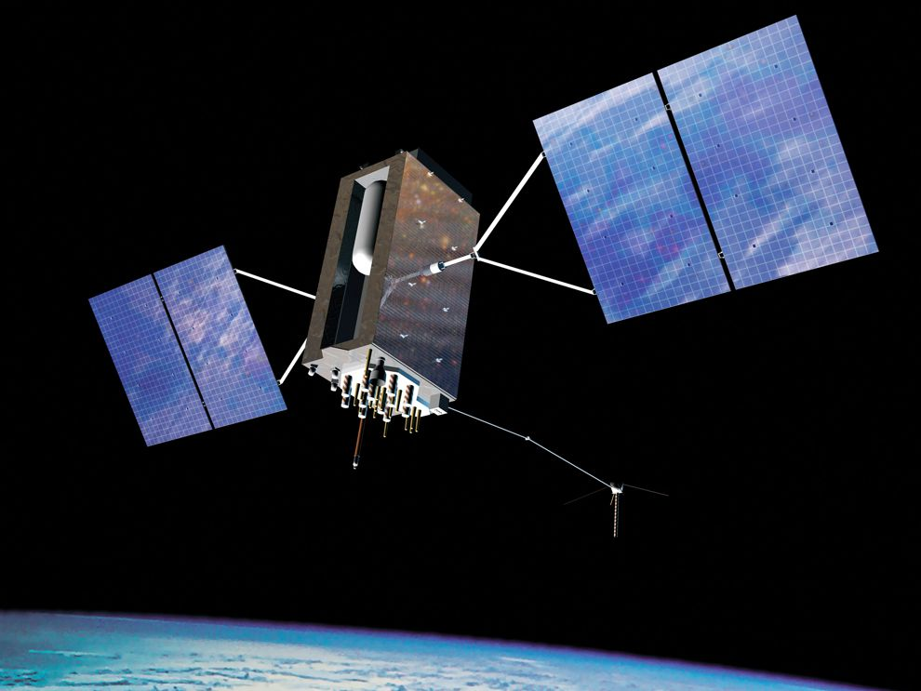
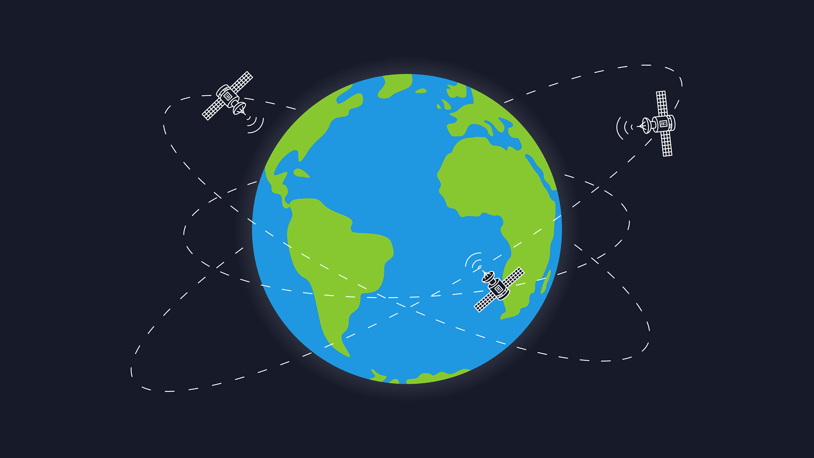
Background knowledge for localization?
How does GPS work?

Slide 35
Global Positioning Service
How does GPS work?
Know the position of all satellites
Receive signals from multiple satellites
Determine distance from each satellite
Trilateration

Slide 36
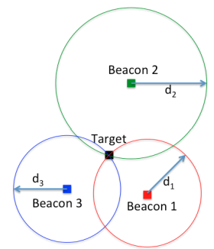
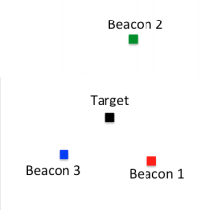
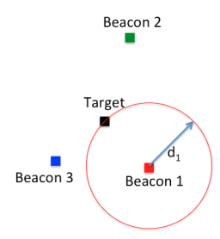
What is trilateration?
Determine distance from each beacon, then find position
Apply trigonometry to solve triangle with beacons.
Requires: 3 lengths (or some angles and lengths…)
Solve two triangles and get 3D position
Most common and accurate localization approach

Slide 37
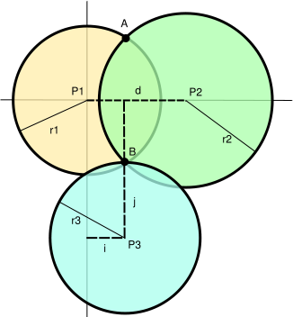
Range based localisation system
Beacon/Anchor/Landmark
Ranging
How many beacons do you need?

Slide 38
What are anchor (beaconing) nodes?
Necessary to localize a network in a global coordinate system, also they can be used for finding relative coordinates
At a minimum
Three (non-collinear) beacons required to define a global coordinate system in two dimensions
Four non-coplanar beacons for 3-D coordinates
Beacon Placement
Significant impact on localization
Improves accuracy if placed in a convex hull around the network, additional beacon at the center

Slide 39
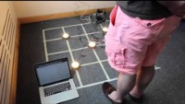
Trilateration using beacons sent using light
Ye-Sheng Kuo, Pat Pannuto, Ko-Jen Hsiao, and Prabal Dutta. 2014. Luxapose: indoor positioning with mobile phones and visible light. In Proceedings of the 20th annual international conference on Mobile computing and networking (MobiCom '14)

Slide 40
How to determine distances?
Making trilateration work requires distance measurements
There are numerous techniques for distance measurement
RSSI (Received Signal Strength Indicator)
Time of Flight/ Time of Arrival
Time Distance of Arrival

Slide 41
Received Signal Strength Indicators (RSSI)
RSSI - received signal-strength indication
In theory, RSSI varies with 1/d^{α}
One common assumption, nodes that are closer have stronger RSSI than those further
In practice, RSSI ranging measurements contain noise on the order of several meters, highly non-uniform
Radio propagation differs over different surface (water, grass, asphalt etc.)
Obstacles such as wall, furniture etc.

Slide 42
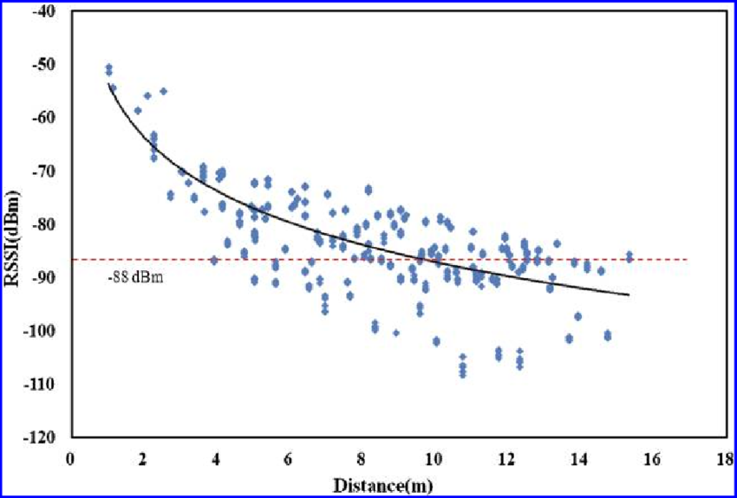
Problem with RSSI-based distance – not accurate
Pathloss is NOT only due to distance
RSSI is way worse at this than you hope it would be
Citation: literally everyone has made this figure at some point

Slide 43
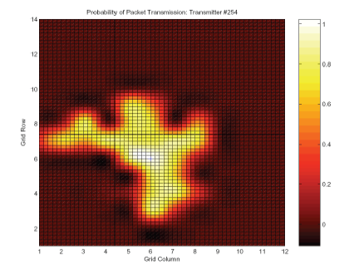
Received Signal Strength Indicators (RSSI)
RSSI utility can be improved with more careful physical analysis of radio propagation or better calibration of sensor radios

Slide 44
Case study: Radio Tomography

Slide 45
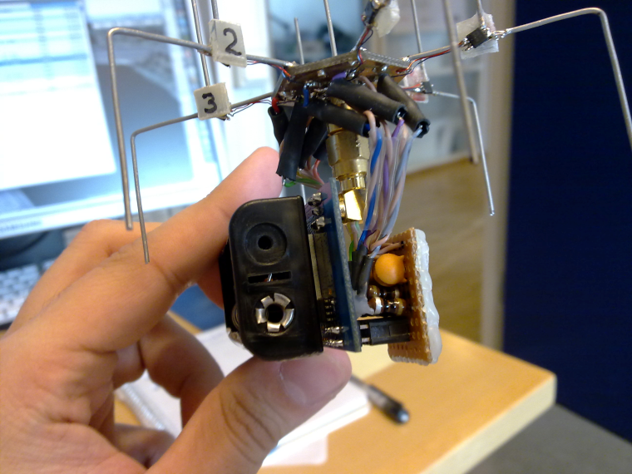
Directional Antenna for Sensing and Communication
What is a directional antenna?
ESD antennas are feasible, simple and inexpensive
SPIDA [1,2] - 6 configurable directions, costs < 5 USD
Power consumption of few microwatts!
[1] Erik Ostrom et al. "Evaluation of an electronically switched directional antenna for real-world low-power wireless networks” – REALWSN 2010
[2] Martin Nilsson. “Directional antennas for wireless sensor networks” - 9th Scandinavian Workshop on Wireless Adhoc Networks 2009
Notes:
- Talk about what is directional antenna
A Directional antenna radiates or receives greater power in specific directions.
An ESD or Electronically Steerable Directional antennas is a type of diretional antena that allows the electronic control of the direction of maximum antenna gain. One example of ESD antenna is the SPIDA which you can see in the slide. These antennas are feasble, simple and inexpensive. E.g., the SPIDA antenna you see on the slide can be configured to six possible antenna direction and costs only 5 USD to make.
Despite advantages offered by ESD antennas, they have not been widely used for NES. The protocols and insights from other wireless networks cannot be applied to NES as they are usually multihop in nature, and they present very different challenge as compared to 1-hop networks.
One of the reasons was lack of testbed to perform experiments with ESD antenna. Initial part of my phd studies looked at designing testbed of WSN nodes equipped with the SPIDA antenna.
Next we discuss two sensing and communication application we explored with the ESD antenna.

Slide 46
Radio Tomographic Imaging
Radio Tomographic Imaging (RTI) - enables sensing by observing attenuation in the RF links in a network caused due to obstructions
Many applications: Human vitals monitoring, fall detection
Directional links provide two advantage for RTI:
Large change in the link quality under obstructions
Obstructions outside the area of interest have a smaller impact
Bo Wei, Ambuj Varshney, Neal Patwari, Wen Hu, Thiemo Voigt, and Chun Tung Chou. 2015. DRTI: directional radio tomographic imaging. In Proceedings of the 14th International Conference on Information Processing in Sensor Networks (IPSN '15)

Slide 47
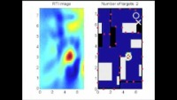
Radio Tomographic Imaging

Slide 48
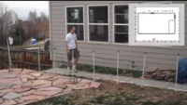
Radio Tomographic Imaging

Slide 49
Directional Radio Tomographic Imaging
Widely used RTI methods with omnidirectional antennas:
mRTI [1] – Mean
vRTI [2] – Variance
cRTI [3] – Multiple channel (mean or variance)
[1] Joey Wilson et al. ”Radio tomographic imaging with wireless networks” in IEEE TMC 2010
[2] Joey Wilson et al. ”See-through walls: Motion tracking using variance-based radio tomography networks” in IEEE TMC 2011
[3] Ossi Kaltiokallio et al. ”Enhancing the accuracy of radio tomographic imaging using channel diversity” In IEEE MASS 2012

Slide 50
Directional Radio Tomographic Imaging
mRTI (NLOS)
cRTI - mean(NLOS)
dRTI - mean(nLOS)

Slide 51
Other Ranging Methods

Slide 52
Time of flight (also known as time of arrival, ToA)
Determine distance by knowing:
Exact position of infrastructure
Transmit time
Receive time
Signal velocity (i.e. speed of light)
Infrastructure transmits and device listens
Can happen all the time, but devices only listen when they want a position
Requires time synchronization between infrastructure and device
Synchronization must be good: 1 μs = 300 meters

Slide 53
Time of flight (also known as time of arrival, ToA)
Important Considerations:
Speed of signal propagation
Distance to be measured
Clock accuracy
Example:
Speed of light (c) ~ 3x10⁸ m/s
Distance travel in 1ms = 300m
Clock accuracy needed for meter accuracy (1/c) ~ 3ns
Speed of sound (v) ~ 330 m/s
Distance travel in 1ms = 0.33m
Clock accuracy needed for meter accuracy = 1/v ~ 3ms

Slide 54
Time difference of arrival (TDoA)
Device transmits and infrastructure receives transmission
Multiple infrastructure nodes receive at different times based on distance
Determine distance by knowing
Exact position of infrastructure
Time of arrival at two different locations
Signal velocity (i.e. speed of light)
Doesn’t require synchronization with infrastructure!
Still requires synchronization between infrastructure nodes
Does require device to transmit loud enough for infrastructure to hear it…

Slide 55
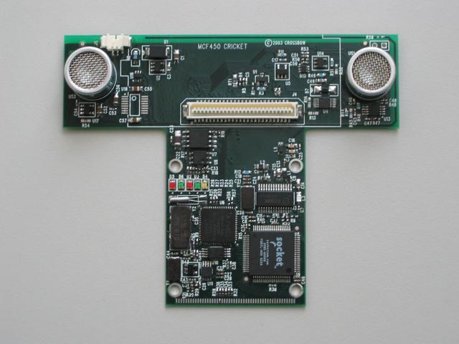
Time difference of arrival with different mediums
Exploit differences in speed, say RF and audio
Example: Cricket System [1]
In addition to a radio, each node also has a speaker and microphone
How does Cricket works?
Transmitter sends a radio message, waits some time (optionally) t_delay, sends audio “chirp” sound
Listener hears the radio signal, record time t_radio
Listener hears the audio signal, record time t_sound
[1] http://cricket.csail.mit.edu/

Slide 56
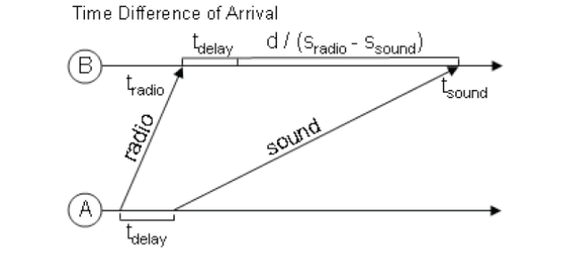
Time difference of arrival with different mediums
Time diff between signal arrival = d/S_{Sound} – d/S_{Radio} + t_{delay}
Works well in LOS environment
Cricket (uses ultra sound) can obtain close to cm accuracy
Requires additional hardware and works better with calibration

Slide 57

Cricket System: Demonstration

Slide 58
How many anchors are needed?
3 anchors gets a 2D location
4 anchors gets a 3D location
Shortcut: if the alignment is right, 3 anchors can do 3D
3 anchors result in two possible points that satisfy equations
One will be on the ground, the other somewhere mid-air or underground

Slide 59
Real-world complication: accuracy
No distance measurement will be perfect
Which means trilateration will not be perfect either
Need to solve equations in a fuzzy manner looking for least error

Slide 60
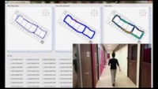
PiLOC System: Localisation system

Slide 61
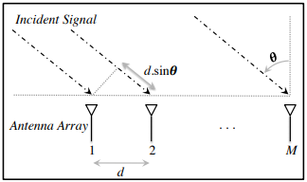
Angle of arrival (AoA)
Trilateration doesn’t only require distances, angles work
Antenna arrays can be used to determine the angle of an incoming signal
Allows the use of normal RF communication (WiFi or BLE)
BLE 5.1 includes AoA localization

Slide 62
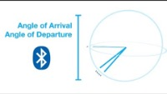
BLE 5 (AOA)

Slide 63
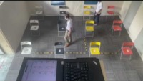
BLE 5 (AOA Positioning Demo)

Slide 64
Global Positioning System (GPS)

Slide 65
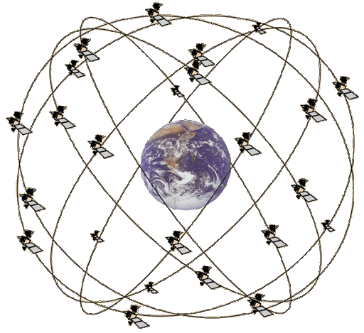
Overview of Global Positioning System
Trilateration using Time of Flight from at least 4 satellites
Satellites in well-known orbits with VERY stable clocks
Satellites placed in Medium Earth Orbit (20,000 KM)
Orbit earth twice per day
Placed such that 4 are in view everywhere, always
31 total in orbit as of November 2020
Most recent launch November 5th 2020
Comparisons
LEO 200-2000 km, ISS at 340 km
GEO 35,000 km

Slide 66
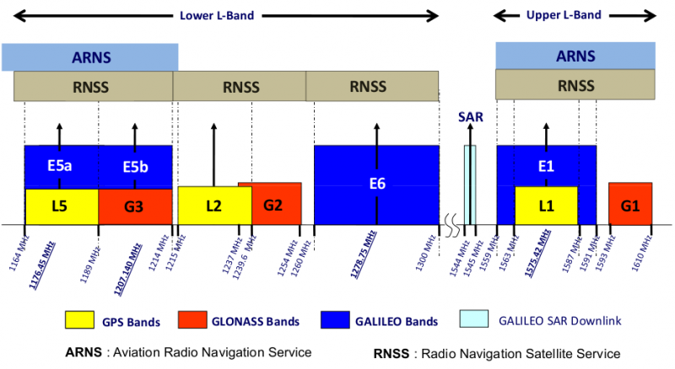
GPS PHY
GPS frequency
1.2 GHz and 1.5 GHz
10-15 MHz bandwidth
BPSK modulation
Signal has to travel 20,000 km, but most of that is through space
Tx power 25 Watts (44 dBm)
Rx sensitivity -140 dBm to -160 dBm (50 bps data rate)
~200 dBm total link budget

Slide 67
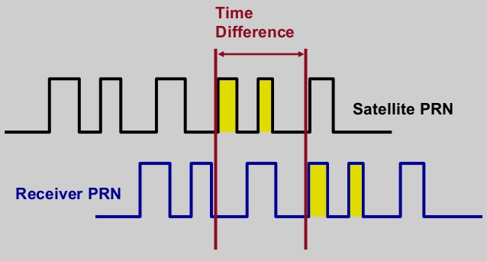
GPS transmissions
Each satellite sends a unique pseudo-random number sequence
Sequence repeats in time (over minutes) and is well-known
Position in signal is used to calculate time of flight

Slide 68
GPS requires signals from multiple satellites
4 satellites are needed to determine location and time
3 for 2D location (assume on ground) and 1 for time offset
Solve for both as a single equation
Steps to finding location
Initialize time to whatever you heard from a satellite (~100 ms sync)
Get time of arrival from four satellites
Four variables
x, y, z, and time offset

Slide 69
Additional GPS data
Receiver needs to know additional information
Current time
Position of each satellite
GPS transmission has this data layered on top (50 bps)
Listening for (up to) 30 seconds gets time and this satellite’s position
Known as ephemeris
Valid for up to 4 hours
Listening for 12.5 minutes gets all satellites’ positions
Known as almanac
Valid for up to two weeks
Cold-start for an embedded device takes significant time

Slide 70
Global Positioning System (GPS)
A set of (>= 24) satellites, orbiting at an altitude of approximately 20,200 km.
GPS satellites have very precise clock
t’_{i} - local time of message reception
t_{i} – timestamp of satellite message
e (unknown) - clock drift (assume same for all satellites)
d_{i} (unknown) - distance between satellite i and receiver
c – speed of light
t_{i}
d_{i}
GPS Receiver
t’_{i} = t_{i} + e + d_{i}/c
https://www.gps.gov/systems/gps/space/

Slide 71
Global Positioning System (GPS)
Equation form by GPS receiver for satellite i
t’_{i} = t_{i} + e + d_{i}/c
Express d_{i} as ( (x – x_{i})² + (y – y_{i})² + (z – z_{i})² )^{0.5}
where (x, y, z) are the coordinates of the receiver
Minimum 4 satellites readings to solve x, y, z and e
Solving e allows clock synchronization
Accuracy of GPS clock: +/-10ns
t_{i}
d_{i}
t’_{i} = t_{i} + e + d_{i}/c
https://www.gps.gov/systems/gps/space/

Slide 72
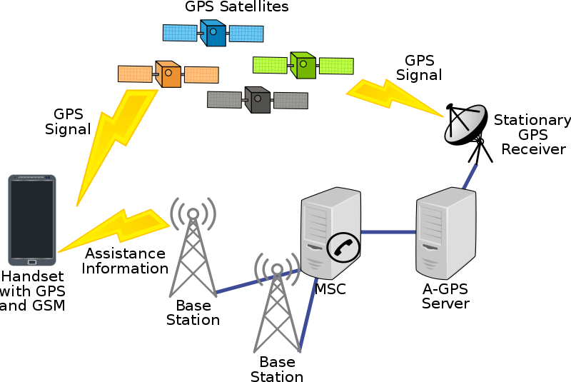
Assisted GPS
How is cell phone GPS so quick?
Download almanac from the internet (only 1.8 kB)
Bootstrap location information
Cell towers can give coarse position
Enables device to know which satellites are overhead

Slide 73
Indoor Localisation

Slide 74
Goal of indoor localization
The goal is positioning things within a building
Where can I find X?
X: where am I located?
X and Y: are we near each other?
Robotic navigation is also important
Although there are many approaches here

Slide 75
Localization classes
Absolute location
X, Y, Z position based on already known infrastructure locations
Like GPS does
Installed localization hardware known as anchors
Relative location
Position relative to some other device
Technically absolute location is a version of this
Might only need a few devices
How far is the smartphone from the computer?

Slide 76
Localization knowledge
What kind of a result is actually useful?
You are at {15, 27.5, 1}
You are at Room 224
Depends on the application
Additional systems on top of the localization method can translate between location representations

Slide 77
Fingerprinting

Slide 78
Mapping existing infrastructure
Can we repurpose existing infrastructure for localization?
For example: WiFi access points
Benefit: localization works with unmodified hardware
Mapping instead of trilateration
Make a map of infrastructure and use that to locate device
Coarse example: existence of WiFi network SSIDs
Fine-grained example: signal strength to each Access Point
Known as fingerprinting

Slide 79
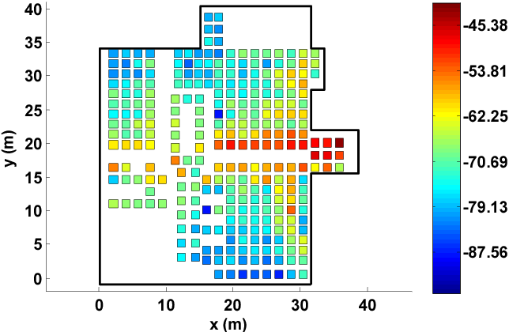
Fingerprinting overview
At setup time, for many locations throughout building
Measure signal strength to Access Point
Record measurement in a database with location
At run time, for the device that wants a location
Measure signal strength to Access Point
Look up measurement in database to get location

Slide 80
Fingerprinting improvements
Measurements can use several Access Points simultaneously
Improves accuracy quite a bit
Doesn’t have to be WiFi based at all
Cellular networks can do fingerprinting
Deploy your own BLE beacons throughout environment
Apply techniques for minimizing error in signal strength
Measurement won’t match record exactly
But minimizing error should approach the same location

Slide 81
Fingerprinting challenges
Effort to create database in the first place
Manually take measurements at every location
Environment is not stable
Signal strength changes as chairs, doors, and people move
Need ability to periodically re-measure
Update database with most recent recording while in use
Measurements vary between devices
Differ based on antennas, cases, how you hold it, etc.

Slide 82
Fingerprinting accuracy
State-of-the-art: median accuracy of 0.5-1.5 meters
Not bad depending on the application!
Likely places you in the right room, or at least nearby
Long tail can be large, but more access points helps this
Barrier problem capability depends on walls
Some materials attenuate signal strength more than others

Slide 83
Similarity of WiFi Fingerprints
Hong, Hande, et.al. "Socialprobe: Understanding social interaction through passive wifi monitoring." Mobiquitous 2016.

Slide 84
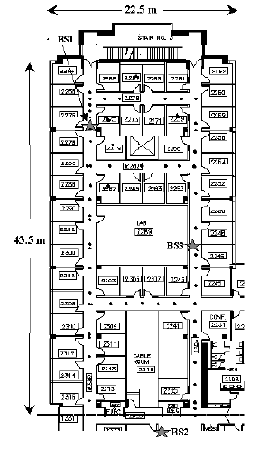
Localization using (WiFi) Fingerprinting
RADAR [2] is one of the earliest & most highly cited localization using WiFi based fingerprinting (>12,000 citations on scholar.google.com)
Testbed:
1 floor, 980 sq. meters, 50 rooms
3 base stations, 1 mobile host

Slide 85
Detecting Social Interaction
Hong, Hande, et.al. "Socialprobe: Understanding social interaction through passive wifi monitoring." Mobiquitous 2016.

Slide 86
Ultra Wide Band

Slide 87
Improving accuracy
To get really good accuracy, let’s return to trilateration
Plan: Send an RF signal from one device and time how long it takes to reach another
Brief transmissions rather than continuous like GPS
Problem: When does this signal arrive?
Need to pick somewhere in rise as the “arrival time”

Slide 88
Multipath problem in wireless propogation
Real-world signals bounce off of things in the environment
Multiple, time-delayed versions of signal arrive at antenna
Result smears out the arrival of energy in time
More reflections mean more peak energy, but longer rise time
This isn’t predictable. Depends on the exact environment configuration

Slide 89
Ultra-wideband yield better localization performance?
Wider bandwidth makes the RF pulse narrower in time
Make it narrow enough, and multipath becomes entirely separate

Slide 90
Ultra-wideband localization system
Narrow ultra-wideband pulses makes arrival timing work
The rest is a copy of well-known techniques
Deploy anchors in the environment with known positions
Measure distance between anchors and device
Time of Flight (if anchors transmit)
Time Difference of Arrival (if devices transmit)
Trilateration to find position

Slide 91
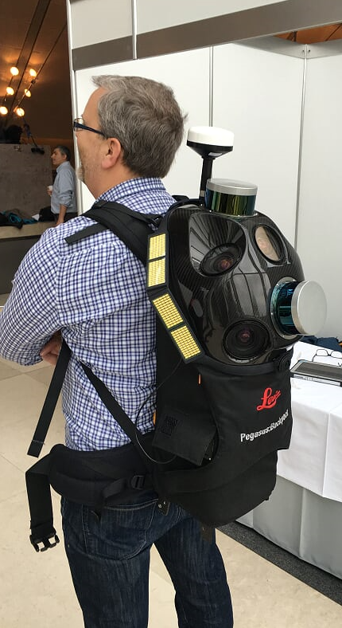
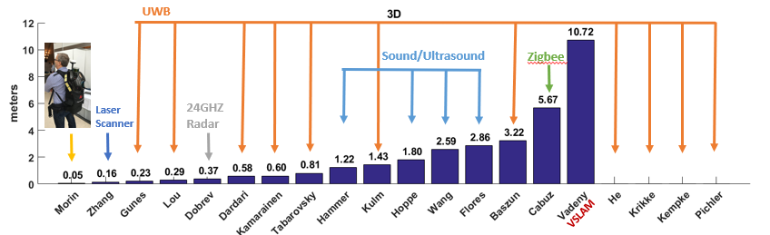
Localization state-of-the art
Microsoft indoor localization competition, 2016
Teams are given a day to measure and deploy their systems in a space
Provide {x, y, z} coordinates using up to 5 anchors in large open room

Slide 92
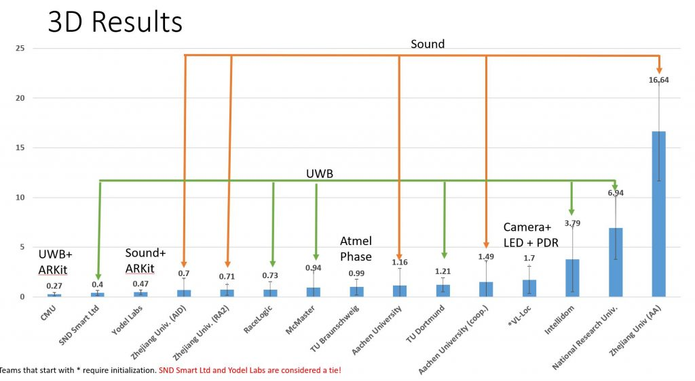
2019 results (Microsoft indoor localization competition)

Slide 93
Improvements to ultra-wideband
Improve results with multiple, diverse measurements
Sources of diversity
Send on multiple channels
Send with multiple antennas
Receive with multiple antennas
Measure each combination of these and average to get better results
Combine with backscatter approaches
Result is very slow (minutes to locate device) but very low power (<1μW)
Most inventory doesn’t move!

Slide 94
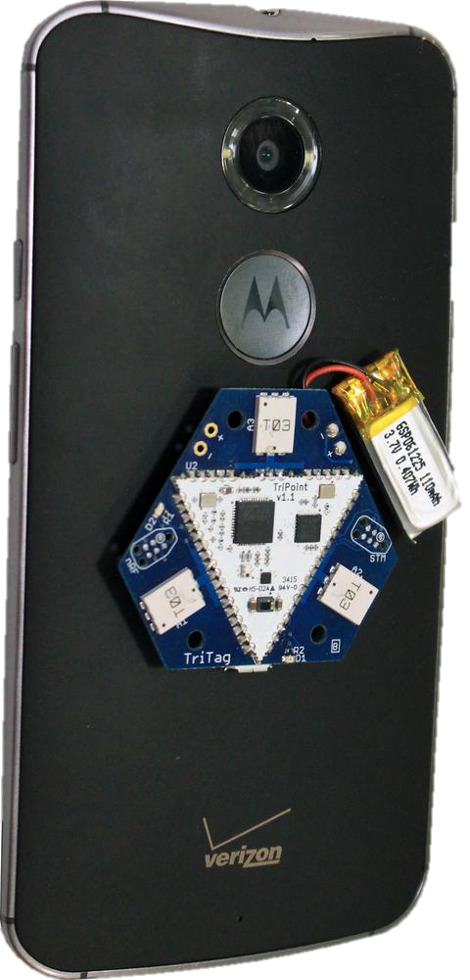
Bringing UWB to the real world
Ultra-wideband radios have been fairly specialized
Needed to build special hardware to use them
iPhone 11 and 12 have UWB radios!!!
Use cases are still a little unclear
Opens a big area of development

Slide 95
Other Techniques

Slide 96
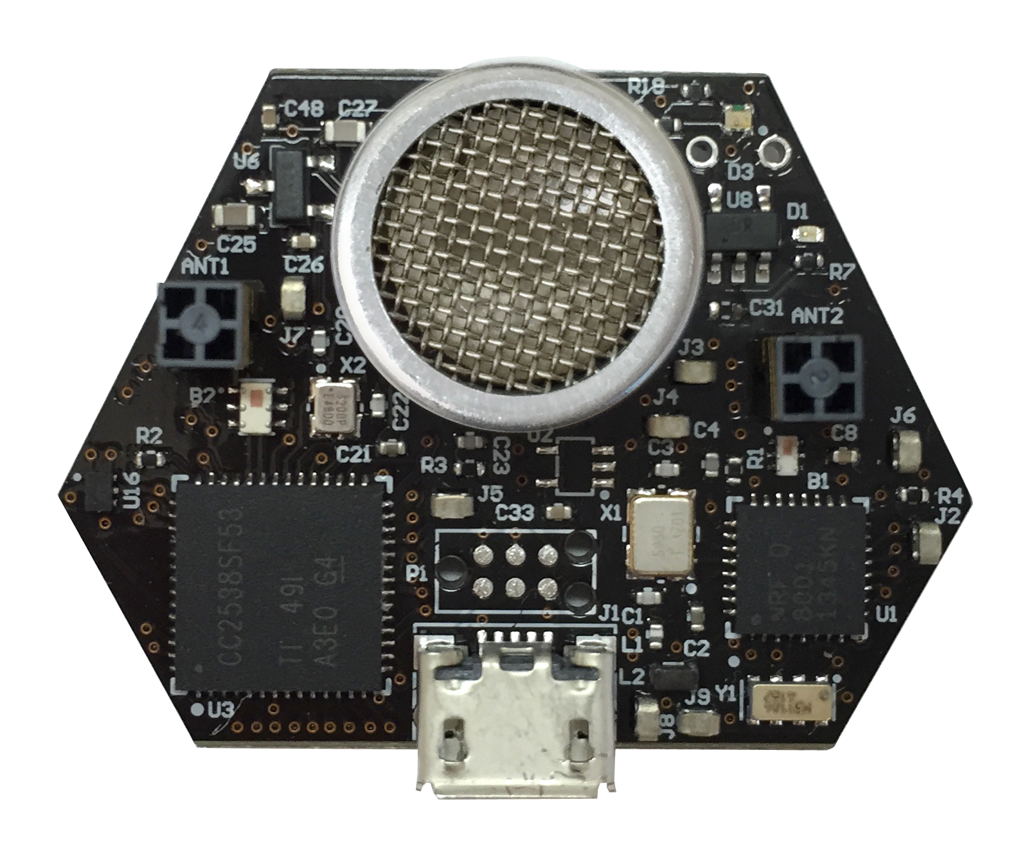
Ultrasound
Advantages
Solves the barrier problem
Human spaces already designed to contain sound
Easier to get high-accuracy results
Sound is ~1,000,000x slower than light
Less synchronization is needed to get same accuracy
Disadvantages
More energy to transmit
Slower update rate (still sub-second)
Limited range
Pets can hear it…

Slide 97
Inertial navigation
If you know acceleration, you can get position, just integrate!
With quite a bit of error
Accurate over short distances with filtering approaches
Can be used to augment other systems
Get a fix every few seconds from localization system
Use inertial navigation to interpolate between measurements
IMUs (Inertial Measurement Units) available in all smartphones
Accelerometer, Gyroscope, Magnetometer

Slide 98
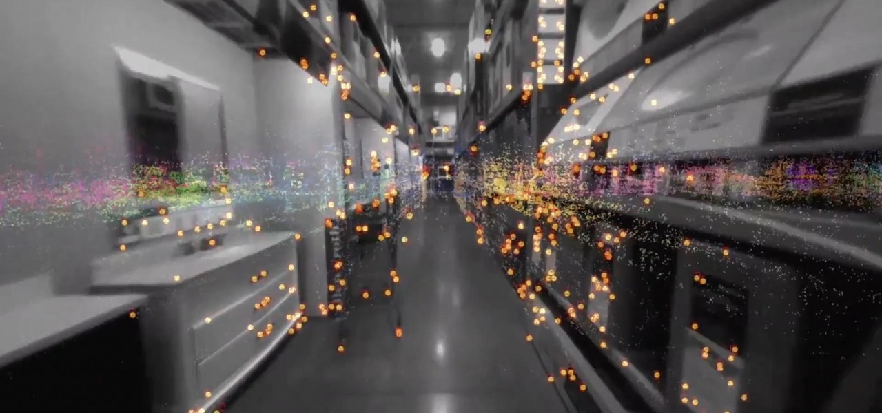
ARKit (and other AR techniques)
Leverage smartphone cameras for positioning
Pictures of a user’s surroundings can be compared to floorplan
Related to SLAM techniques (Simultaneous Localization And Mapping)
Can build an incredibly accurate system
With a bit of bootstrapping
Probably applies most to robotics use cases

Slide 99
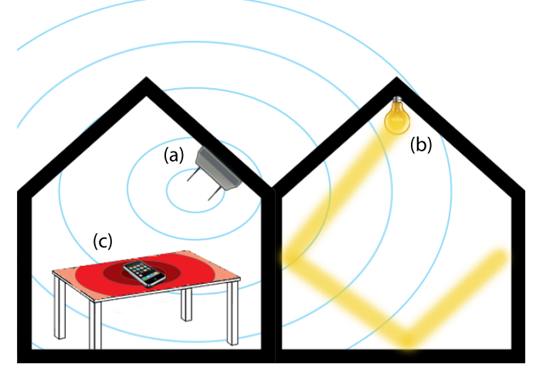
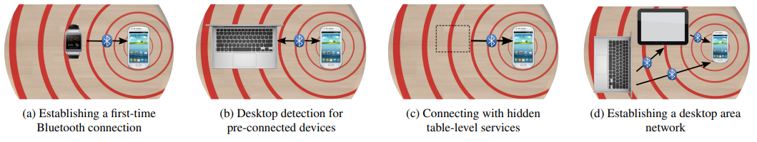
Vibrations
Determine shared context of a table
Vibratory motors and IMUs are common
Signaling demonstrates nearby devices

Slide 100
Learning Objective for Today’s Lecture
Review: last few lecture’s topics
Localisation basics and RSSI
Case Study: Radio Tomography
Other Ranging Methods
Global Positioning System
Indoor Localisation
Fingerprinting
Ultrawide band
Other methods

Slide 101
Wireless Networking
Ambuj Varshney
Assistant Professor, National University of Singapore
Wireless, Embedded Intelligence, Sensing, and Emerging Technologies Group
ambujv@nus.edu.sg

Slide 102
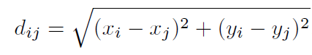
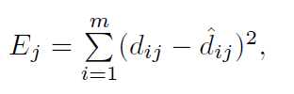
Problem
There is no point (x,y) that satisfies all constraints.
Let d_{ij} denotes the distance between anchor i and node j
d
Estimation Error:

Slide 103
Multilateration: Example
X4 = (10,0)
X3 = (10,10)
(45)^{0.5}
(52)^{0.5}
X
(47)^{0.5}
(55)^{0.5}
X1 = (0,0)
Y
X2 = (0,10)

Slide 104
Write down the constraints:
x² + y² = 47
x² + (10 – y)² = 55
(10 – x)² + (10 – y)² = 52
(10 – x)² + y² = 45
No value of x and y meet all 4 constraints.
Rewrite the equations (x₁=0, y₁=0, x₂=0, y₂=10, ….)
(x – x_{i})² + (y- y_{i})² = d_{i}²
-2xx_{i} -2yy_{i} + x² + y² = d_{i}² – (x_{i}² + y_{i}²)
Let R = x² + y²
-2x_{i}x -2y_{i}y + R = d_{i}² – (x_{i}² + y_{i}²)

Slide 105
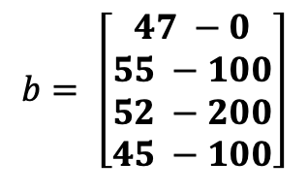
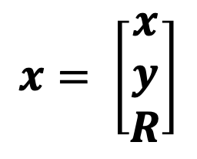
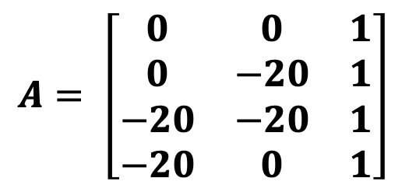
Recall:
In this case,
$$A= \left[\begin{matrix}0 & 0 & 1 \\ 0 & −20 & 1 \\ −20 & −20 & 1 \\ −20 & 0 & 1\end{matrix}\right]$$
$$b= \left[\begin{matrix}47 −0 \\ 55 −100 \\ 52 −200 \\ 45 −100\end{matrix}\right]$$
$$x= \left[\begin{aligned}x \\ y \\ R\end{aligned}\right]$$
x = 5.125, y = 4.625, Ej = 0.004578664
Note, R = 47.25, x² + y² = 47.65625

